Slide 1

.
DEDAN KIMATHI UNIVERSITY OF TECHNOLGY PROJECT PROPOSAL FOR DEGREE IN BSc. INFORMATION TECHNOLOGY BY KIMANI PATRICK GICHINGA (C025-01-0966/2015) EBURSARY SYSTEM SUPERVISOR MR. MICHAEL KAMAU Submitted in partial fulfillment of the requirements for award of degree in BSc. Information Technology

Slide 2
EBURSARY SYSTEM
Background
Bursary is a monetary award given by institution to a learner to cater for his/her studies.
NARC and Jubilee government pledged free education to Kenyan children.
Government doesn’t meet all the requirements.
Hence, it becomes a burden to low-earning parents.
If institutions can provide bursaries to learners as part of giving back to the community, this burden would be no more.
This system therefore aims to create a centralized platform where bursaries will be accessible to everyone despite his/her geographical location.

Slide 3
Problem statement
Access to bursary form from SOME companies may be hectic if one has to travel to where these institutions are located to get the forms. Also, knowing which companies that wish to offer bursaries may be difficult. However, after one has applied for the bursary, it may also be difficult to recognize if he/she managed to be awarded the bursary. One may be forced to keep on calling the institution’s management to request for the same. If officer in-charge of bursaries in a particular institution speaks contrary to what the student expected, he/she may never be encouraged to apply again even though he/she is needy.

Slide 4
Objectives
1.3.1 General objective
The main objective of an EBS is to create a widely accessible system that will link learners to institutions offering bursaries.
1.3.2 Specific objectives
To create a system that will provide timely information about bursary application forms posted on the system by sending emails to the bursary beneficiaries.
To create a system that will ensure only genuine needy students acquires bursary through e-requesting to the respective authorities.
To create a system that will diversify bursary issuance over a large geographical area.
To create a system that will enhance efficiency on provision of bursary e.g. making access to bursary from various institutions easy and time-saving.
To create a database that store records for needy students who apply for bursaries to various institutions and the amount that one acquired.

Slide 5
Problem justification
Most of the countries have pledged to provide free education, but they are unable because their GDP is still low. If it(free education) is provided, not all the requirements of the learner are catered for. Parents are forced to pay some fees to cater for fees and stationaries. Those who are not in a position to provide fees, their young ones end up dropping out of the school.
If institutions were involved in provision of bursaries to this learners, there could be no cases of drop outs.
Scope
Ebursary system will be expected to be commonly used in institutions of learning e.g. universities, secondary schools etc. and those that are willing to offer bursaries to students.

Slide 6
LITERATURE REVIEW
-> Research from various systems:
Gaps
Wishbone system – population benefiting from the system is very small compared to the donations awarded to them. majorly because they come from few selected countries e.g. Los Angeles.
Latymer foundation – Alumni donates towards this foundation, hence sources of funds is limited.
Kin Canada system – donations are made by individuals and organizations. They are aimed at funding projects that will support the livelihood of the community. However, one has to be a member of the foundation, hence very few persons benefits.
Higher Education Loan Board – bursaries provided by HELB are few. Instead, they provide loans which is repayable with interest rate. If the leaner lacks job, he/she will not be in a position to raise the cash hence loan amount continues to accumulate.

Slide 7
Summary
Most of the system allows donors across the country or even from worldwide to donate funds to them despite them having a very small population to donate to. In addition, most of them are much specific with the academic level they fund i.e. university/college, secondary etc.
Ebursary system will involve all companies which wishes to offer bursaries to students at any part of the country as part of community building.

Slide 8
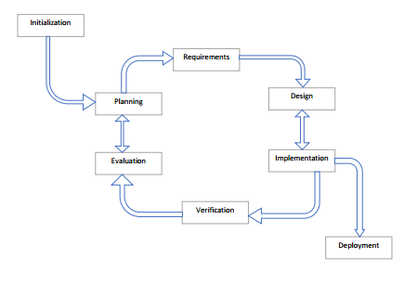
CHAPTER THREE: METHODOLOGY
Iterative model
-> Iterative model is a system development model will be most preferable model to develop web-based systems. This is because, it focusses on initial, simplified implementation which then progressively gains more complexity and a broader feature set until the final system is complete.

Slide 9
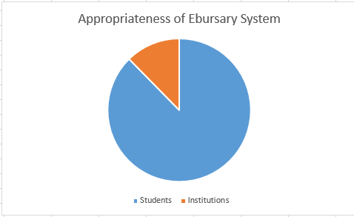
Facts finding methods
Questionnaires
-Questionnaire will be used to collect general opinion of the respondent is required and shall be used when a specific answer is required.
Past records
-Make use of the existing materials e.g. online materials to get information on the approximate number of students
who are in need of the bursary and
how Ebursary system will benefit
them.
Data presentation
-Pie charts was used to present the
outcome of the results. To test the
appropriateness of the system

Slide 10
Resources
Hardware
Computer (4GB RAM, core i5 CPU 2.53GHz, 500GB HDD).
Hard disk
Modem
Software
Xampp server
Laravel framework
Browser e.g. chrome
Editor e.g. atom
Windows OS (64-bit OS)

Slide 11
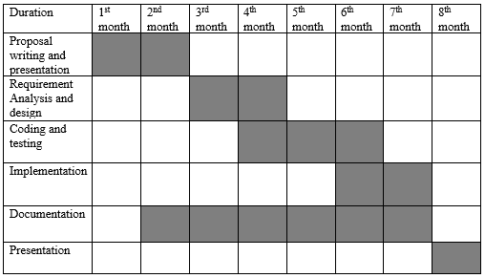
Appendices Appendix A: schedule

Slide 12
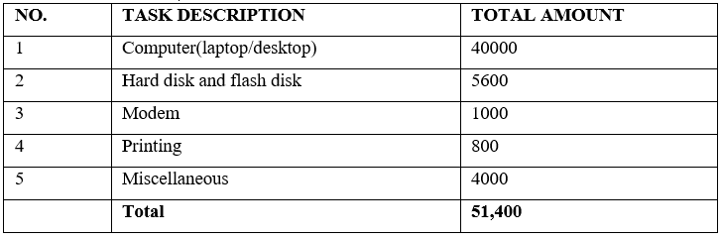
Appendix B Table 3.1 Budget

Slide 13
References
Constituency Development Fund. (2017, August 12). In Wikipedia. Retrieved from https://en.wikipedia.org/w/index.php?title=Constituency_Development_Fund&oldid=795157511
Donate - Kin Canada. (n.d.). Retrieved May 31, 2018, from http://www.kincanada.ca/donate
HAL ROGERS ENDOWMENT FUND / KIN CANADA BURSARIES | Ways To Give. (n.d.). Retrieved May 31, 2018, from https://www.canadahelps.org/en/charities/hal-rogers-endowment-fund-kin-canada-bursaries/
Higher Education Loans Board - Empowering Dreams. (n.d.). Retrieved May 26, 2018, from http://www.helb.co.ke/single-page.php
Jubilee’s free secondary education to kick off smoothly » Capital News. (2017, June 24). Retrieved May 29, 2018, from https://www.capitalfm.co.ke/news/2017/06/jubilees-free-secondary-education-kick-off-smoothly/
Kenya Law: Kenya Community Development Foundation. (n.d.). Retrieved May 31, 2018, from http://kenyalaw.org/kl/index.php?id=147
Latymer Foundation Hammersmith. (n.d.). Retrieved May 31, 2018, from http://www.latymerfoundation.org/
ogola.pdf. (n.d.). Retrieved from http://www.ossrea.net/publications/images/stories/ossrea/ogola.pdf
‘The Children Act’ Review: Emma Thompson’s Best Role Since ‘Wit’ – Variety. (n.d.). Retrieved May 30, 2018, from http://variety.com/2017/film/reviews/the-children-act-review-emma-thompson-1202553219/
Wishbone. (n.d.). Retrieved May 26, 2018, from https://www.wishbone.org/

